Slide 1

An Approach For
Building a POINT OF Sale System of Customer Food Ordering
for Green Cafeteria

Slide 2

Green University of Bangladesh
Department of
Computer Science & Engineering
The
presenter
Presenting to
Name: Jahidul Islam
Std ID: 221002504
MS. AYESHA KHATUN
Lecturer
Dept. of CSE
Green University of Bangladesh

Slide 3
Table of Contents
Introduction
Brief Overview
Graphical View of Project

Slide 4
INTRODUCTION
Where
Why
Problems
Solution
Manual entry of Product to calculate Debit-Credit for a larger amount of transaction become hard to maintain
Application based on Java Swing can be developed and initialized to store the daily transaction.
Rapid uses of Cafeteria in become difficult to maintain.
To manage and automate Cafeteria Services

Slide 5
Debit-Credit
&
Point of Sale System
01
POS System?
02
Why Using Java Swing
03
Is java secure?

Slide 6
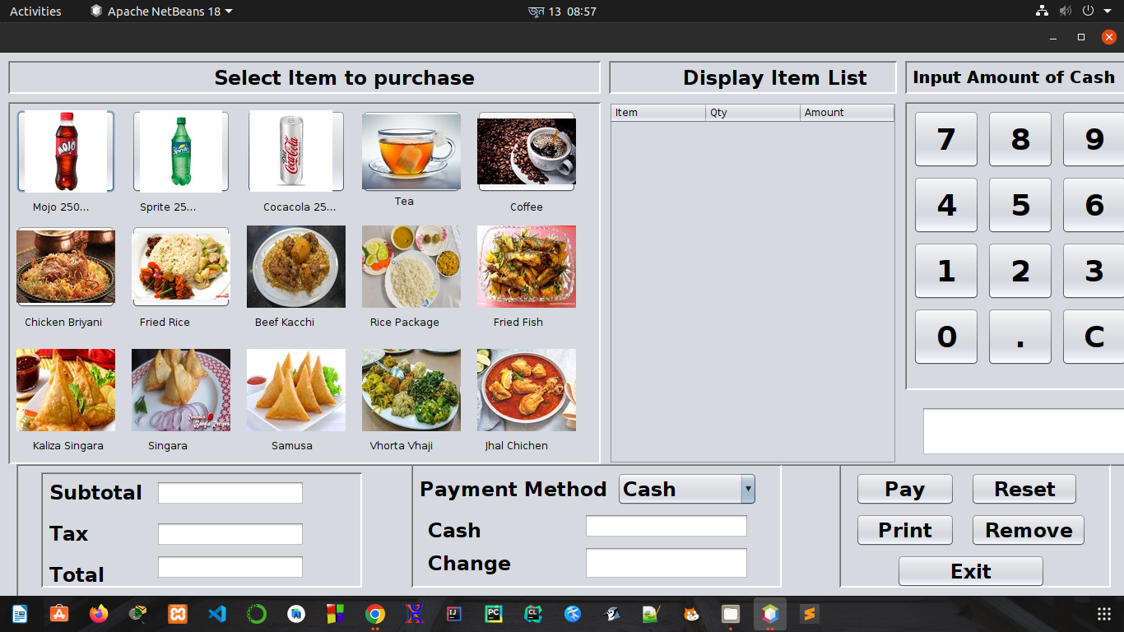

Slide 7
References
Reference links

